Slide 1
DriverPass System Analysis
Valerie Dawson
Notes:
Welcome to the presentation of the DriverPass System. This system is designed to streamline online and in-person driver training, ensuring an efficient and user-friendly experience for both customers and administrators.

Slide 2
System Requirements
Functional Requirements
Non-Functional
Requirements
Allow customer to create accounts and log in securely
Provide online practice tests and instant feedback
Allow instructors to log student progress and provide feedback
Enable users to schedule, modify, and cancel driving lessons
Ensure administrators can manage users and oversee system operations
The system must be web-based and responsive on all devices
Support up to 1,000 concurrent users without performance degradation
Implement secure authentication and data encryption.
Ensure regular system updates every 3-6 months for security and feature enhancements.
Notes:
The DriverPass System must support online training, scheduling in-person lessons, managing customer accounts, and handling secure payments. It must be accessible via web browsers and mobile devices while ensuring performance, security, and scalability. These requirements ensure the system is efficient, user-friendly, and secure for all stakeholders.

Slide 3
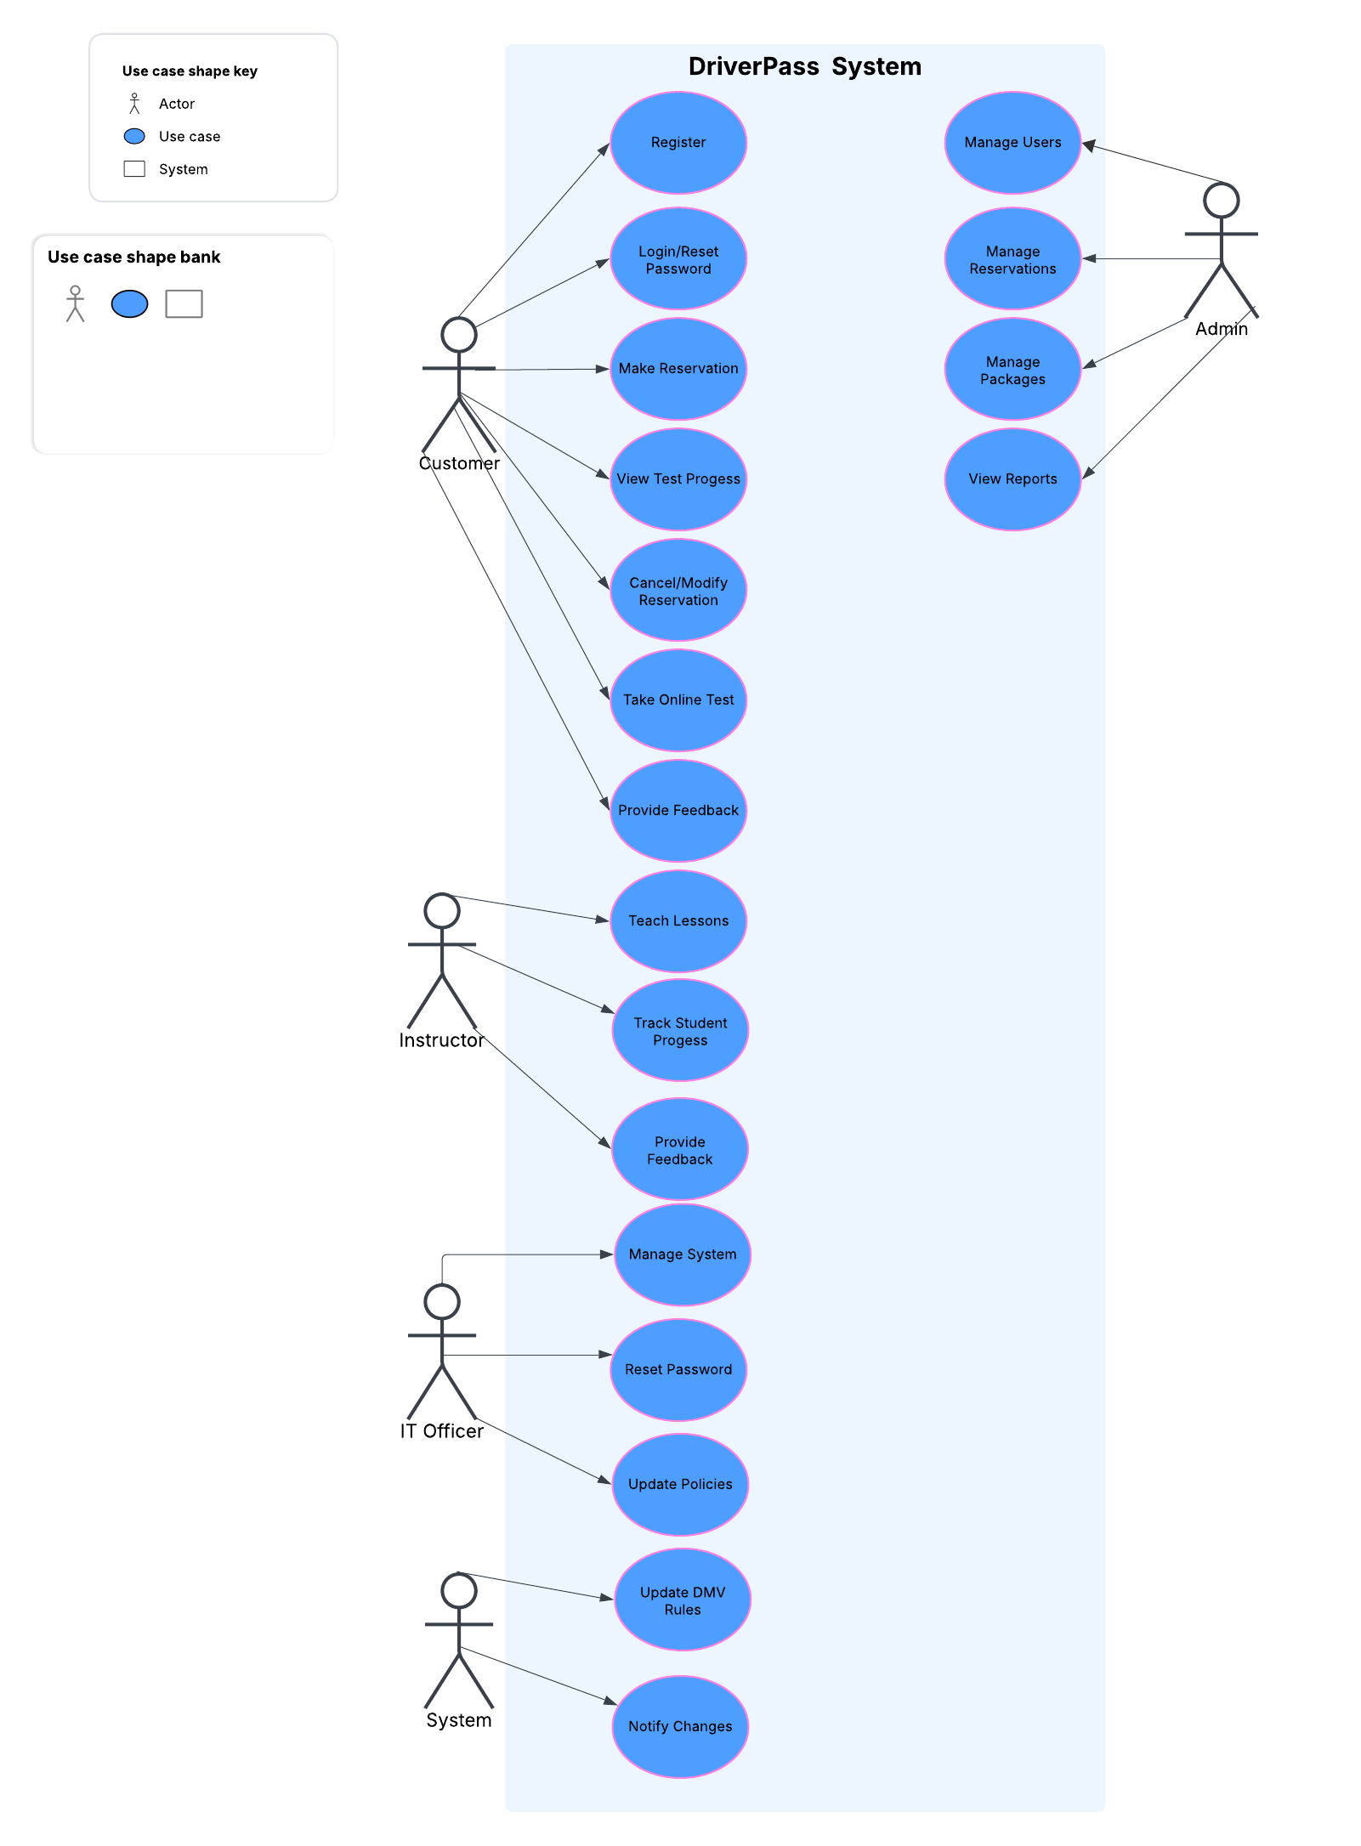
Use Case Diagram
Notes:
This diagram outlines how different users interact with the system. At the center of the diagram, you’ll see the DriverPass System, which connects to all the key users. The key users are The Customers, they can register, log in, book or modify lessons, take online tests, track their progress, and provide feedback. The Instructors, they teach lessons, track student progress, and share feedback to help student improve. The Administrators, they manage user accounts, reservations, and packages, as well as generate reports to monitor business performance. Finally, IT Administrator Ian can maintain the system, reset passwords, and update polices to ensure everything runs smoothly. The system also includes automated features, such as updating DMV rules and notifying users of changes. This diagram captures all the essential functionalities requested during the DriverPass interview. Ensuring that every user group has the tools needed, while the system itself handles critical updates and notifications for a seamless experience for everyone involved.

Slide 4
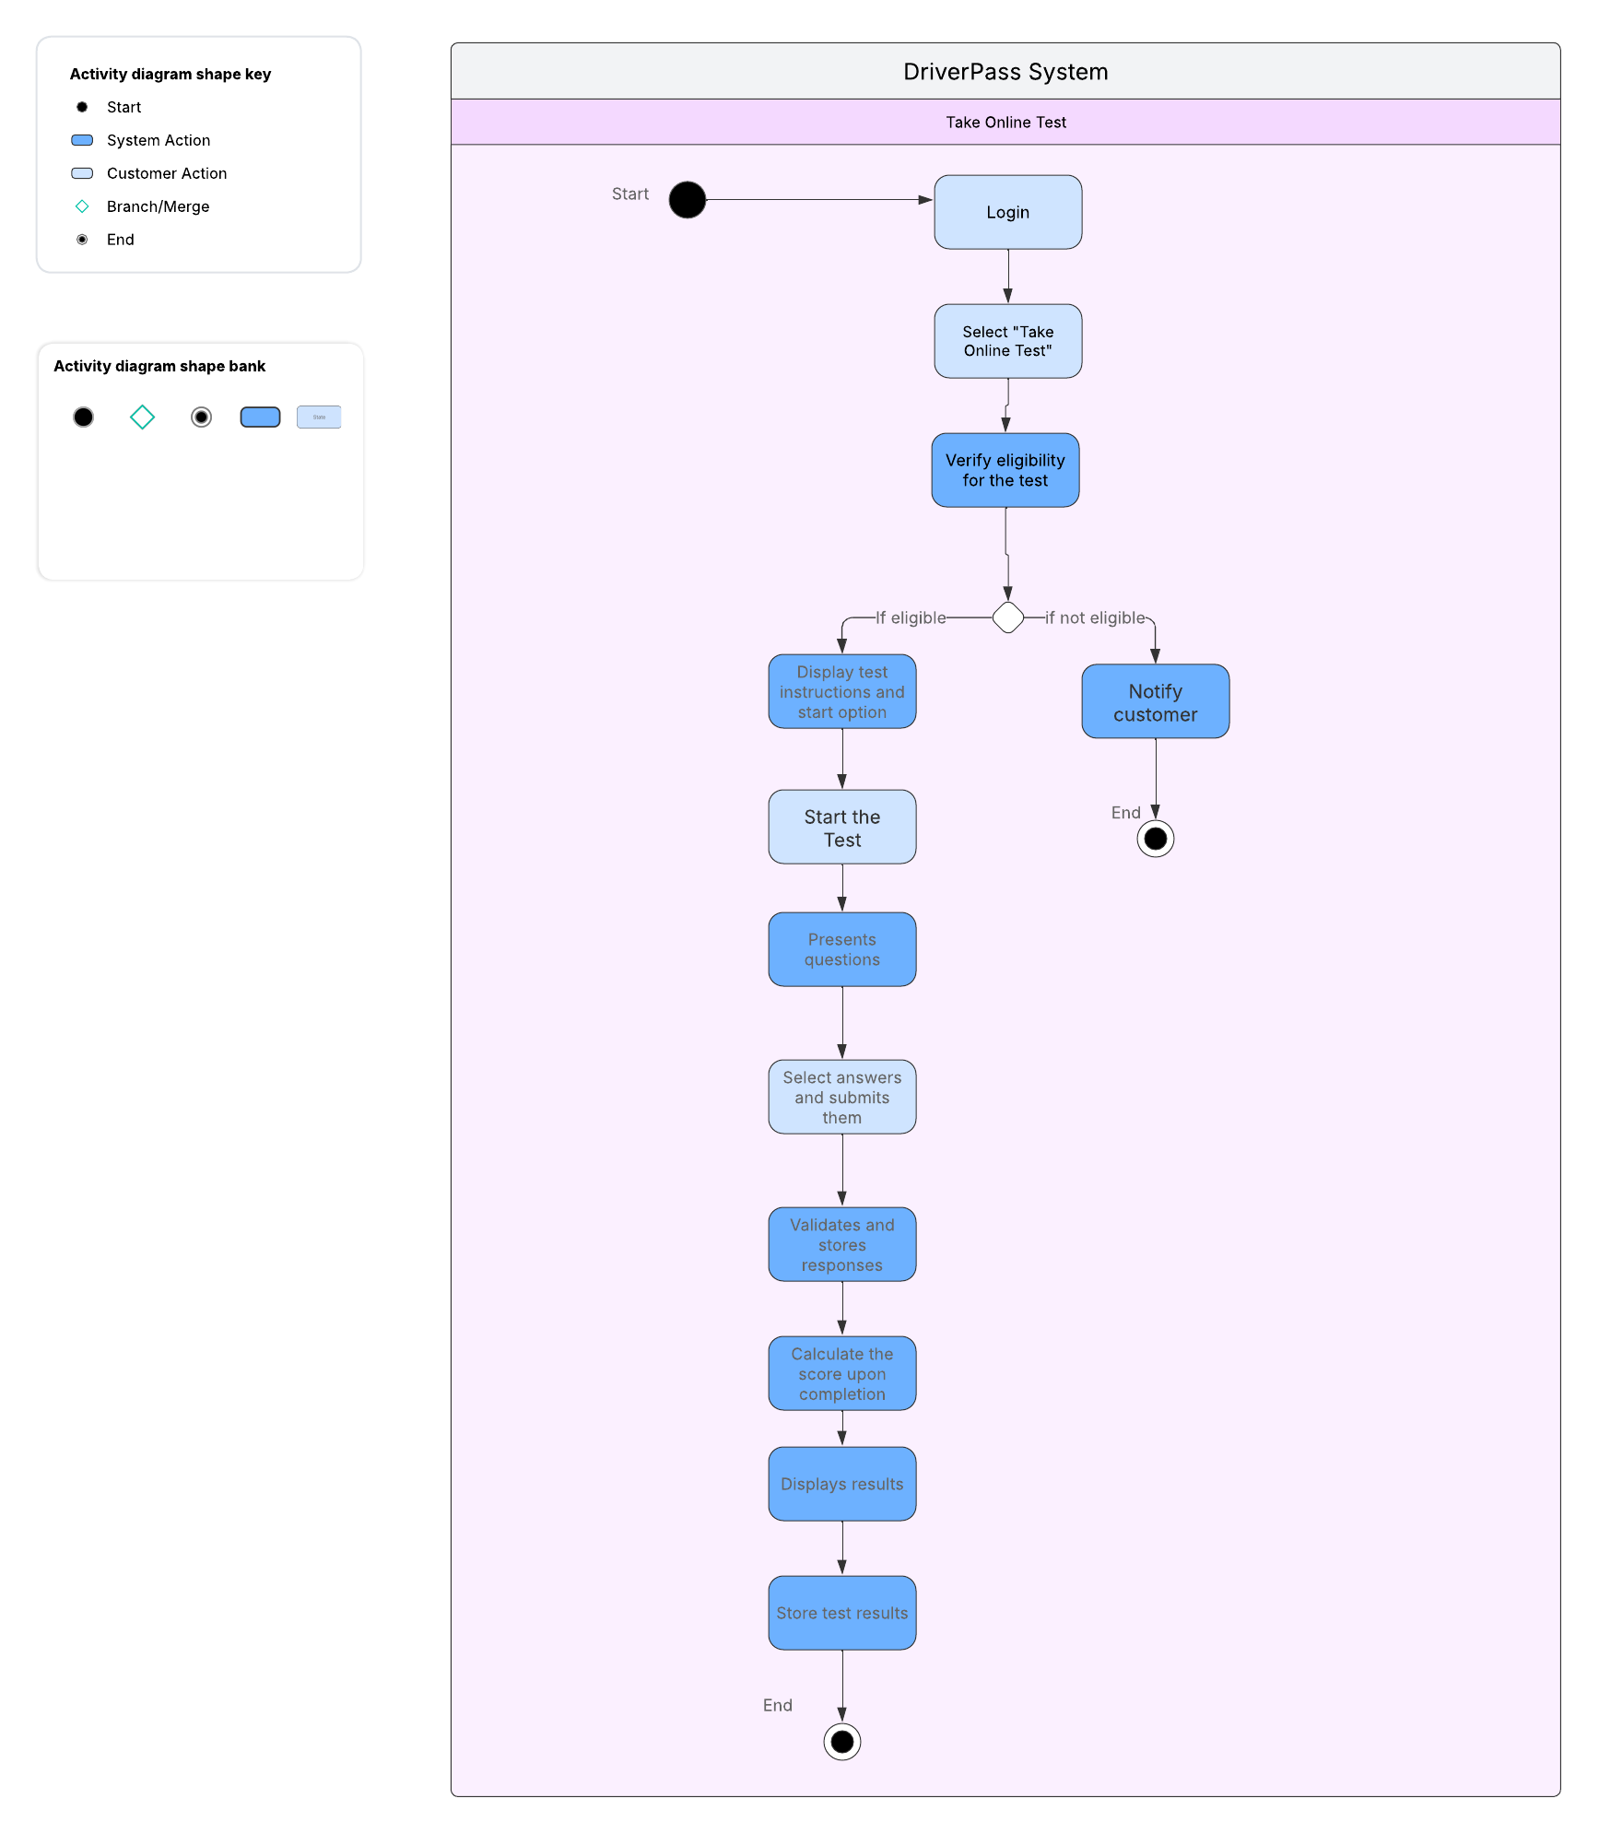
Activity Diagram
Notes:
Here illustrated is the key processes for taking an online test. The online test flow involves the customer logging in, selecting the “Take Online Test” option, the system verifying eligibility, the customer answering questions, the system validating the questions submitted from the customer, and the customer receiving instant feedback from the system upon test completion. Ensuring a smooth and intuitive user experience for customers.

Slide 5

Security
Secure user authentication using encrypted credentials
HTTPS encryption for safe data transmission
Role-based access to ensure only authorized users perform specific tasks
Account lockout mechanisms to prevent unauthorized access attempts.
Notes:
Security is a critical aspect of DriverPass. The system enforces encrypted logins, secure payment processing, and protection against unauthorized access. Measures include account lockouts after multiple failed login attempts and password recovery via secure email links. These measures protect user data and maintain system integrity.

Slide 6
System Limitations
Initial deployment is focused on specific geographic regions
Budget constraints may impact infrastructure scalability
Reliance on third-party services for DMV updates and payment processing.
Requires stable internet access for optimal performance
Notes:
Currently, the system prioritizes online testing and scheduling, with road training data integration planned for later. Initial deployment with focus on specific regions with potential for expansion. Budget and infrastructure constraints may limit user capacity at launch.

